Slide 1
Caesar Cipher
By: Tajae Richards, Sukhjot Singh

Slide 2
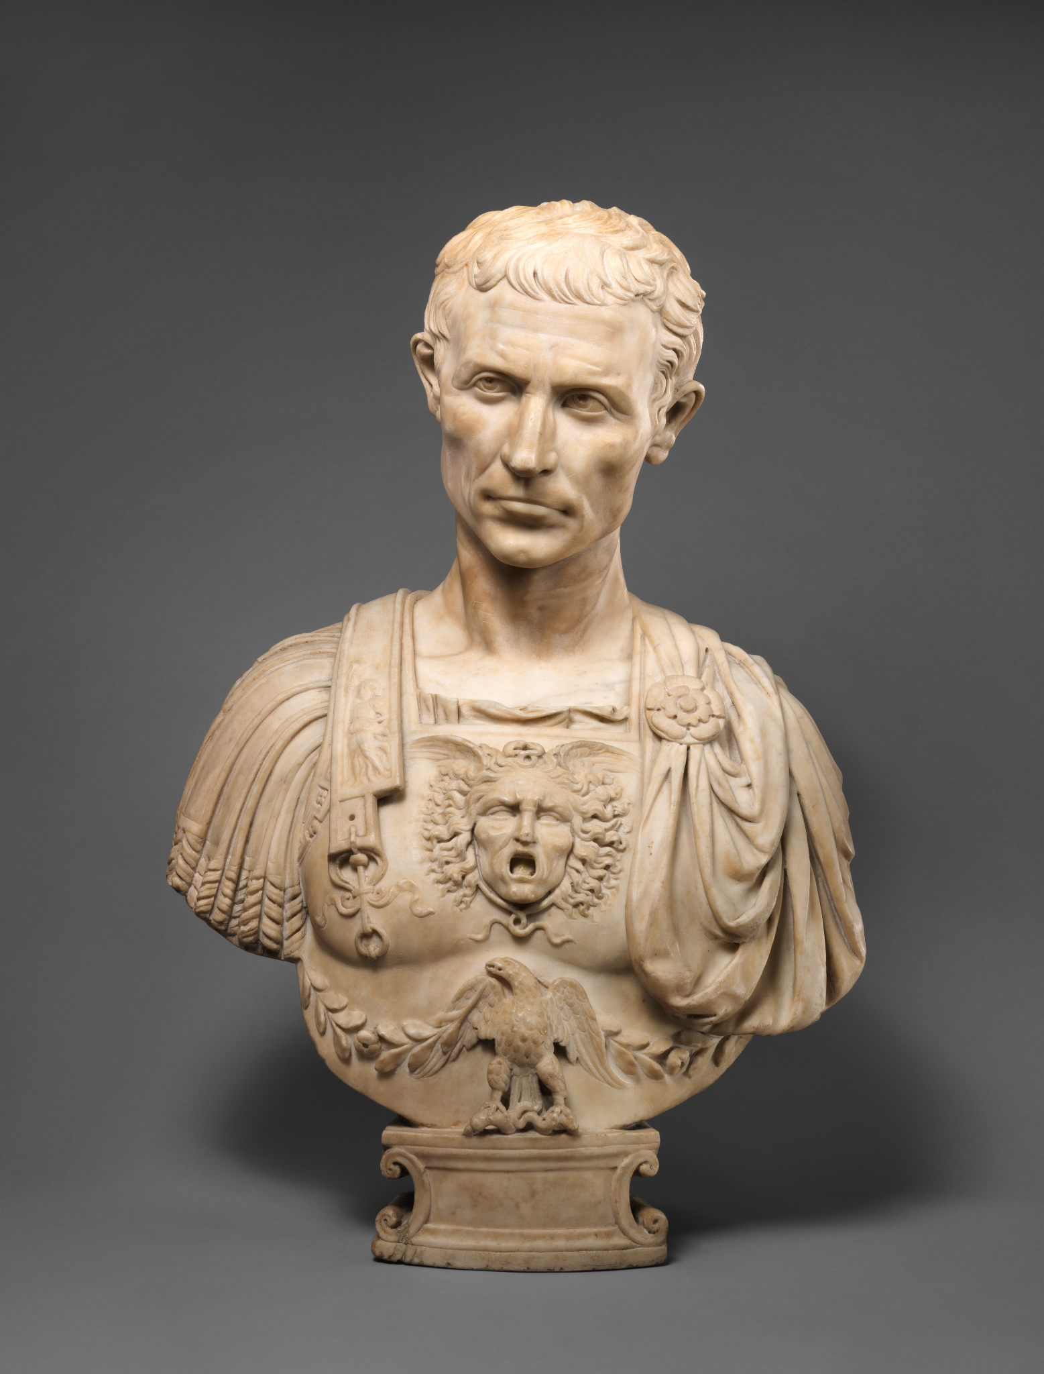
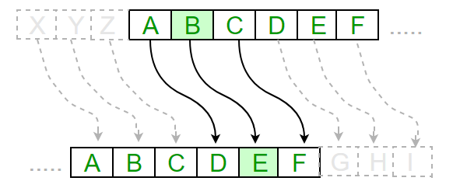
History of the Caesar Cipher
Invented by Julius Caesar - Approximately 58 BC
Utilized in his military campaigns
Acknowledged as one of the earliest methods of encryption
It was also used by other military leaders
Notes:
https://www.britannica.com/topic/Caesar-cipher

Slide 3
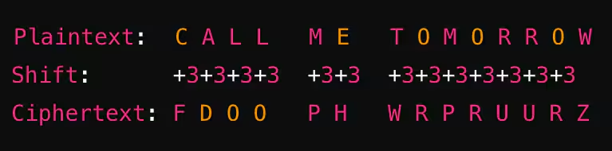
Encryption/Decryption Method
A Simple Substitution Method:
Each letter in a message is shifted a set amount in the alphabet
Shift is the number of letters being moved down the alphabet
Assign each letter in the alphabet with a number starting from A = 0
Decryption:
To decrypt a caesar ciphered text you must move up the alphabet by the shift value
Notes:
https://www.geeksforgeeks.org/ethical-hacking/caesar-cipher-in-cryptography/

Slide 4


Applications of the Cipher
Not used for serious encryption today
Early used to secure military operations
Foundation for cryptography and encryption
Used in education for basics of cryptography

Slide 5
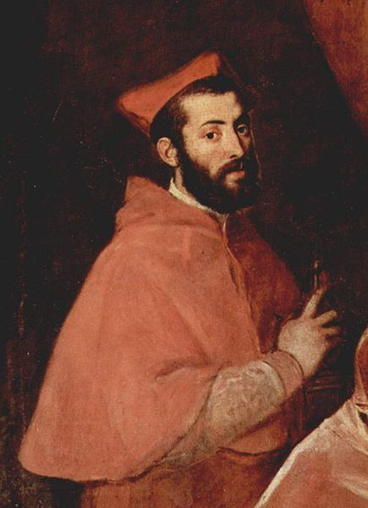
Final days of the Caesar Cipher
Due to ease of decryption, a new variation being made:
The Caesar Cipher became outdated during the mid 15th century (for serious use)
The cipher is easily decrypted:
Frequency-Analysis method
Only has 26 possible shifts
A new variation was made:
Giovan Battista Bellaso created a more secure variation of the caesar cipher (Vigenère cipher)

Slide 6
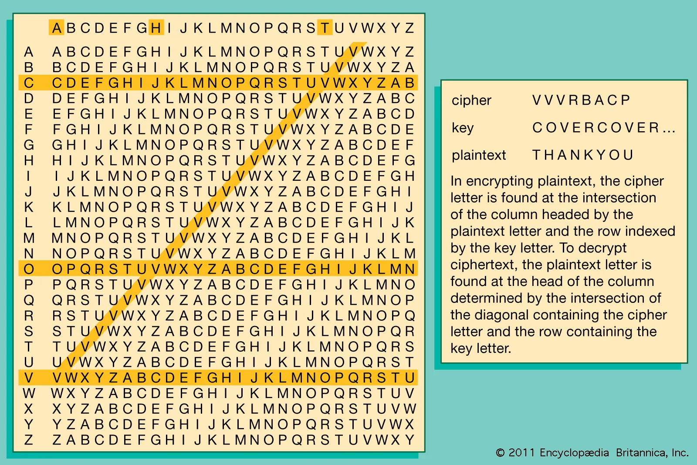
Evolution of the Caesar Cipher
Towards the middle of the 15th century:
The once heavily triumphant Cipher developed by Julius Caesar become obsolete due to decryption methods like Frequency-Analysis
A new Vigenere Cipher was developed as a result:
Multiple shifts were utilized instead of 1
Polyalphabetic substitution:
The positioning of the same letter can encrypt to different letters
Too many new possible keys to this cipher prevent the leading decryption methods to work

Slide 7
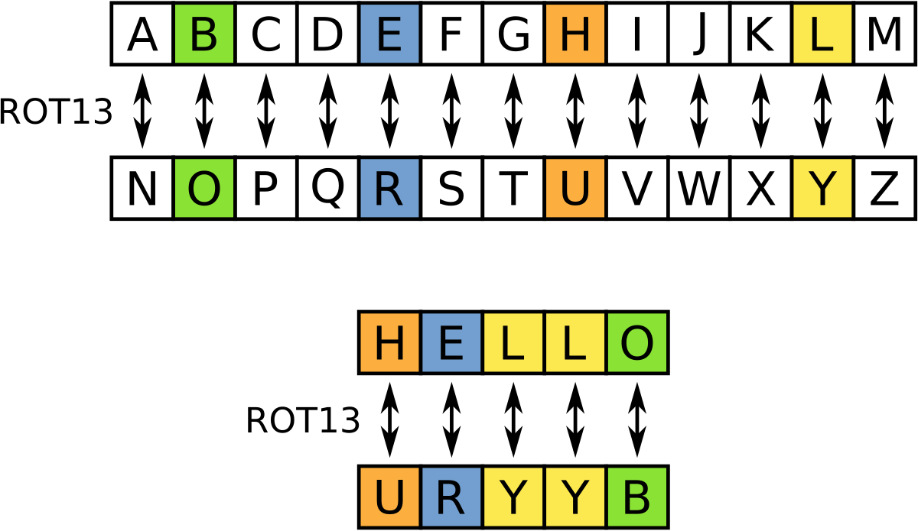
Modern Day Caesar Cipher
Although the Caesar Cipher isn’t secure anymore, it still has practical uses today:
ROT13 (Rotate by 13)
A version of the Caesar Cipher which shifts the letters in the Cipher 13 places
Applying the Cipher onto itself twice outputs the initial text (26 letters in the alphabet/13 places)
Is used in entertainment and media to lightly encrypt messages
Used as an introduction to cryptography in computer programming
User friendly and it remains a simple way to demonstrate the inner workings of ciphers
http://rot13.com/

Slide 8




Modern Day Implications
Laid the foundation for modern encryption
Introduced the idea of key-based encryption
Served as inspiration for modern day ciphers such as AES, RSA
Encrypts everyday communication (emails, VPNS, messages)
Encrypts online transactions (crypto, online shopping)

Slide 9
Works Cited:
www.splunk.com/en_us/blog/learn/caesar-cipher.html
www.geeksforgeeks.org/ethical-hacking/caesar-cipher-in-cryptography/
courses.cs.washington.edu/courses/cse490h1/19wi/exhibit/artifacts/crypto.pdf
antigonejournal.com/2021/09/cracking-caesar-cipher/
rot13.com/
medium.com/@cybertec/encryption-through-the-ages-from-caesar-to-quantum-1b3045bc767d
garantir.io/the-caesar-cipher-vs-modern-cryptography-from-ancient-secrets-to-quantum-proof-encryption/

